Slide 1
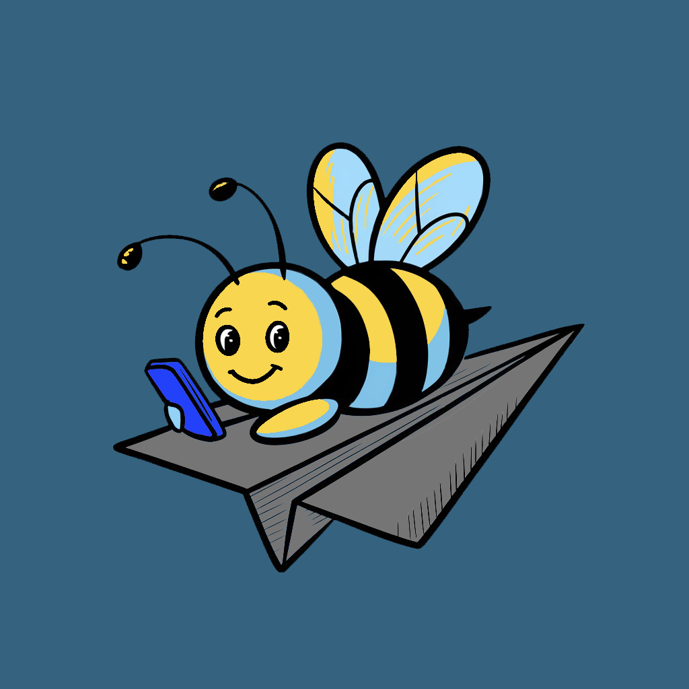
BeeBlue.shop
AI-Powered Instagram Shopping Assistant

Slide 2
The Problem
Inspiration-Purchase Gap
Limited Shoppability
Inefficient Visual Searches
Instagram is a major source of product discovery but lacks a seamless “buy now” experience
Most posts aren’t tagged, forcing users to manually search for products
Text-based searches fail when users have only an image as inspiration

Slide 3
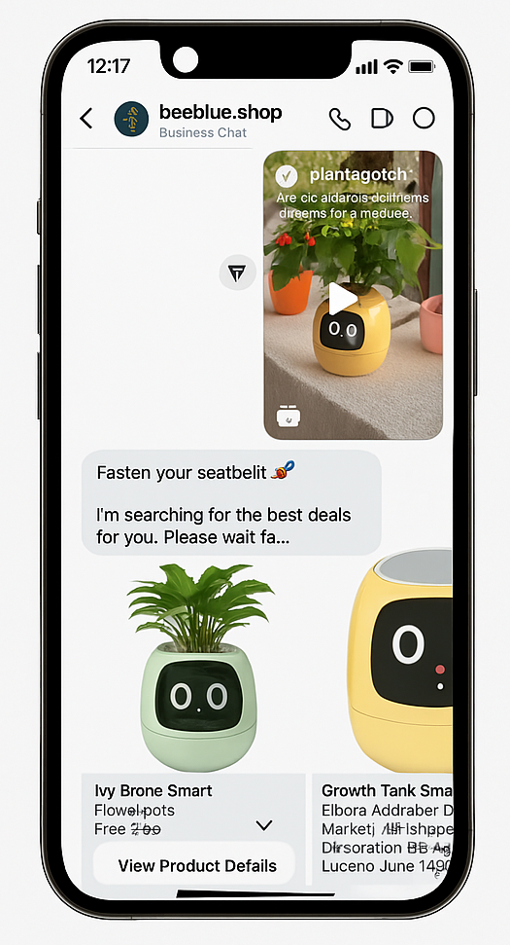
Our Solution
BeeBlue.shop
AI-driven assistant integrated with Instagram DM
How It Works
Users send any IG post (image, reel, or share) via DM
Advanced AI analyzes the content
Instantly returns a list of the Top 5 matching products

Slide 4
Market Opportunity
Instagram’s Influence
Instagram Users
2 billion
72% influenced to purchase
Booming Social Commerce
Visual Search as the Next-Gen Shopping Tool
$1.2T by 2025

Slide 5
Product Overview
Free for users with limited queries on reels and unlimited image analysis
AI identifies and extracts multiple products from the post
2
“Top 5” shoppable results delivered via DM
4
1
3
DM an Instagram post to BeeBlue
User asked to select one of recognized products

Slide 6
Competitive Landscape
Visual Search Tools
AI Shopping Assistants
Influencer Platforms
Google Lens
Pinterest Lens
Amazon StyleSnap
Aesthetic.ai
FitCheck
Snapchat Screenshop
LTK
ShopStyle
Instagram Shopping
Our Differentiation
Works on any Instagram post
Seamless DM experience
Cross-category & multi-brand coverage without manual tagging

Slide 7
Business Model
Free Core Service for Users
Limited queries on reels; unlimited image analyses
Monetization Streams
Affiliate Revenue: Earn commission on referred sales
Sponsored Placements: Branded product recommendations
Influencer Collaborations: Revenue sharing with micro/mid-tier influencers
Premium Features (Future): Subscription tiers, personalized style consulting
Data Insights: Aggregated trends for brands and retailers

Slide 8
Go-to-Market Strategy & Traction
Initial Traction
Growth Tactics
MVP launched, early organic DM queries and growing IG presence
Instagram native content & influencer partnerships
Viral hashtag campaigns (e.g., #FoundWithBeeBlue)
Paid Instagram ads and PR outreach
Goal
Achieve 1M Instagram followers in 6 months

Slide 9
Financials & Funding Ask
Team Costs
API/Data fees
Marketing & Growth
DevOps Engineer
Tech Infrastructure & API Costs
Influencer campaigns, ads, content creation
Senior Consultant
Cloud & AI processing

Slide 10

Growth & Revenue Roadmap
🎯 Follower Target: 5,000
👤 Active Users (10%): 500
📈 Total Usage: 30,000
💰 Total Cost: 1,000 CAD
📊 Affiliate Revenue: 1,000 CAD
🎯 Follower Target: 100,000
👤 Active Users (10%): 10,000
📈 Total Usage: 600,000
💰 Total Cost: 3,000 CAD
📊 Affiliate Revenue: 21,000 CAD
🎯 Follower Target: 350,000
👤 Active Users (10%): 35,000
📈 Total Usage: 2,100,000
💰 Total Cost: 7,000 CAD
📊 Affiliate Revenue: 73,000 CAD
Followers: 500K
1
3
5
2
4
6
🎯 Follower Target: 30,000
👤 Active Users (10%): 3,000
📈 Total Usage: 180,000
💰 Total Cost: 1,000 CAD
📊 Affiliate Revenue: 6,000 CAD
🎯 Follower Target: 200,000
👤 Active Users (10%): 20,000
📈 Total Usage: 1,200,000
💰 Total Cost: 3,500 CAD
📊 Affiliate Revenue: 42,000 CAD
🎯 Follower Target: 500,000
👤 Active Users (10%): 50,000
📈 Total Usage: 3,000,000
Total Cost: 8,000 CAD
📊 Affiliate Revenue: 105,000 CAD

Slide 11
Cost-to-Revenue Analysis
Steps | Followers | Active Users | Usage Volume | Total Cost (CAD) | Affiliate Revenue (CAD) | Net Profit/Loss (CAD)
Month 1 | 5,000 | 500 | 30,000 | 1,000 | 1,000 | 0
Month 2 | 30,000 | 3,000 | 180,000 | 1,000 | 6,000 | +5,000
Month 3 | 100,000 | 10,000 | 600,000 | 3,000 | 21,000 | +18,000
Month 4 | 200,000 | 20,000 | 1,200,000 | 4,000 | 42,000 | +38,000
Month 5 | 350,000 | 35,000 | 2,100,000 | 7,000 | 73,000 | +66,000
Month 6 | 500,000 | 50,000 | 3,000,000 | 8,000 | 105,000 | +97,000
Total | - | - | 7,110,000 | 22,379 | 248,000 | +226,000
📝 Notes:
Usage Volume = Active Users × 3 requests/day × 20 days
Affiliate Revenue = 1% of Usage Volume × CAD 50 average order × 7% commission

Slide 12
Thanks!
Any questions?

